Slide 1
MarkLogic Data Hub Intelligent Approach + Smart Technology Michel de Ru, Senior Principal Solution Engineer
Notes:
Key Takeaway:
What is MarkLogic? It’s the world’s best database for integrating data from silos.
Talk Track:
This presentation is intended to provide an overview of MarkLogic – both the database product and the company behind it. My name is [insert name] and I am a [insert title] at MarkLogic. I am excited today to tell you a bit about why MarkLogic is the world’s best database for integrating data from silos. Data integration is a significant problem and MarkLogic has an innovative approach to solving it.

Slide 2
Data Services First approach
resembles
Data Services First approach

Slide 3
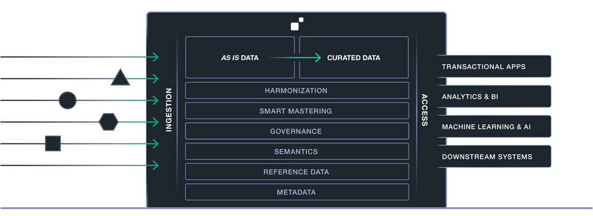
MarkLogic Data Hub Platform
WORK FROM BUSINESS VALUE BACK TO SOURCE SYSTEMS
UNIFIED PLATFORM
ADVANCED SECURITY
LOAD DATA AS IS
SMART CURATION
SIMPLE DEVELOPMENT

Slide 4
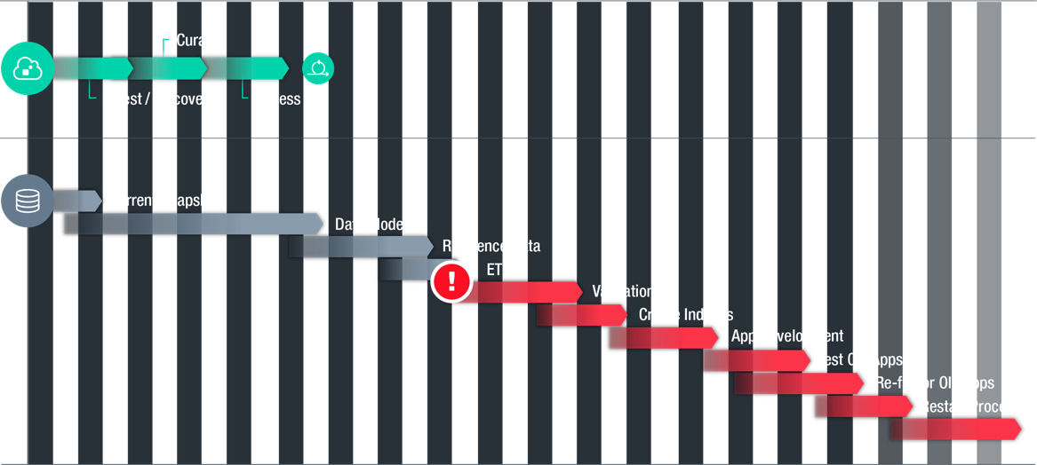
Data Hub = 10-12x Faster
Purpose built solution MarkLogic Data Hub
Best of breed integration database, indexer, ETL, security, catalog, lineage, provenance

Slide 5
Traceability allowing for Accountability Michel de Ru, Senior Principal Solution Engineer
Notes:
Key Takeaway:
What is MarkLogic? It’s the world’s best database for integrating data from silos.
Talk Track:
This presentation is intended to provide an overview of MarkLogic – both the database product and the company behind it. My name is [insert name] and I am a [insert title] at MarkLogic. I am excited today to tell you a bit about why MarkLogic is the world’s best database for integrating data from silos. Data integration is a significant problem and MarkLogic has an innovative approach to solving it.

Slide 6
Why Traceability By Default?
REGULATORY CONTEXT
Financial services companies operate in a heavily-regulated marketplace
Governments, regulators and industry bodies are currently demanding greater levels of transparency, accountability and compliance from financial institutions
COMPLIANCE COST
Falling short of your compliance requirements can lead to fines, penalties and legal actions. Even going through an audit costs significant time and money
FUNCTIONALITY COST
Higher compliance standards can also translate into greater software functionality and ultimately, more work for your team

Slide 7
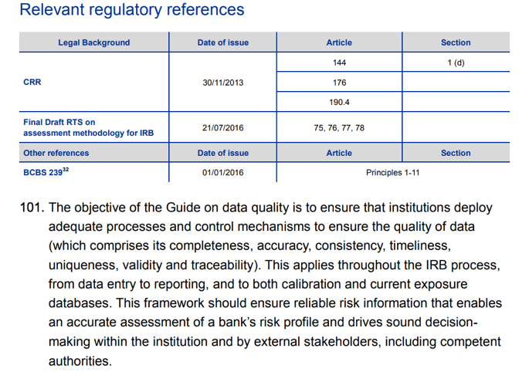

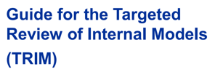
Example: TRIM regulation

Slide 8
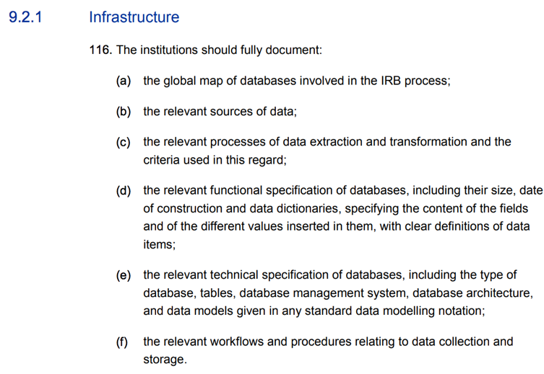
Example: TRIM regulation
``````````````````
``````````````````

Slide 9
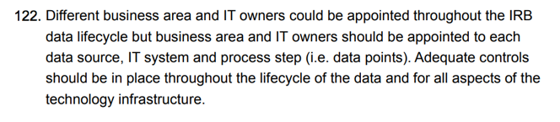
Example: TRIM regulation

Slide 10
Typical traceability questions
“How was this result conceived”
“Which steps were involved in this calculation”
“What do the data elements mean”
“Which source data was used for this process”
“What version of the source data do I have”
“Who loaded it into the system and when”
“When was the process called and how long did it take”
“Who ran this process and why”
“Which enrichments were done on this data”
“What external data was used for this information”

Slide 11
Typical end-to-end process
Ingest
Harmonize
Use
“Which source data was used for this process”
“What version of the source data do I have”
“Who loaded it into the system and when”
“Which steps were involved in this calculation”
“Which enrichments were done on this data”
“What external data was used for this information”
“How was this result conceived”
“What do the data elements mean”
“When was the process called and how long did it take”
“Who ran this process and why”

Slide 12
A model for end-to-end traceability
The PROV Ontology
W3C recommendation 2013

Slide 13
Actors for traceability
Entity This is about the data itself
Activity A process that was called using or producing the data
Agent The responsible actor using the data (Entity) or process (Activity)

Slide 14
Relationships between actors
Was Generated By
Was Derived From
Was Attributed To
Started At Time
Ended At Time
Used
Was Informed By
Was Associated With
Acted On Behalf Of

Slide 15
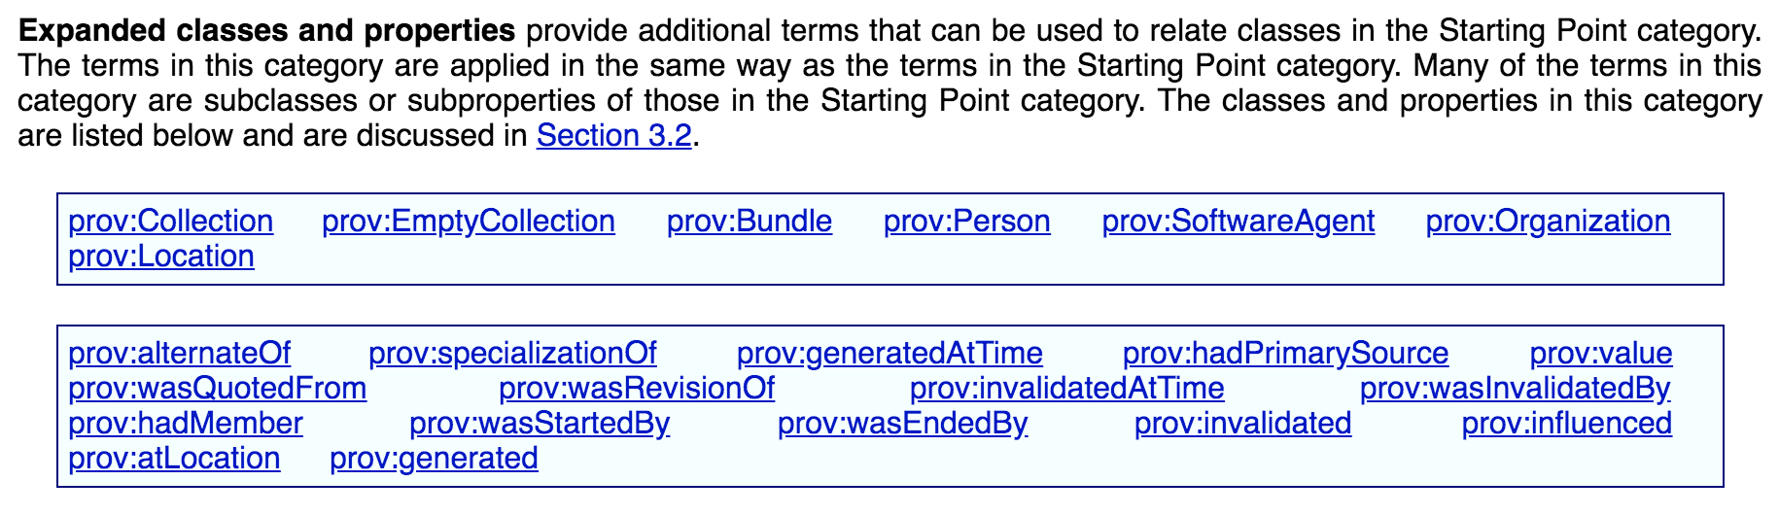
And many more

Slide 16
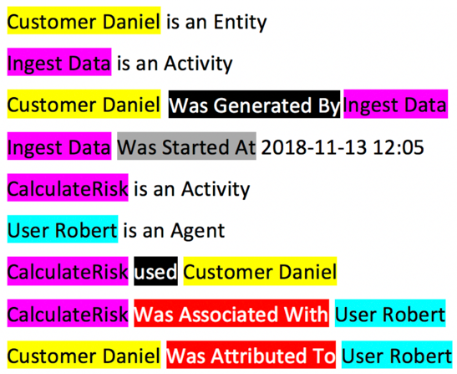
Example

Slide 17
Conclusion
PROV-O is a world wide standard, kept by W3C
PROV-O allows for full end-to-end lineage and provenance
Full lineage and provenance allows for traceability
Traceability is a pre-requisite for accountability
Accountability provides for a good night sleep in a regulated vertical!

Slide 18
Movie Palace Demo Michel de Ru, Senior Principal Solution Engineer
Notes:
Key Takeaway:
What is MarkLogic? It’s the world’s best database for integrating data from silos.
Talk Track:
This presentation is intended to provide an overview of MarkLogic – both the database product and the company behind it. My name is [insert name] and I am a [insert title] at MarkLogic. I am excited today to tell you a bit about why MarkLogic is the world’s best database for integrating data from silos. Data integration is a significant problem and MarkLogic has an innovative approach to solving it.

Slide 19
Introducing Movie Palace

Slide 20
Disconnected data increases churn
CRM
Rentals
Marketing

Slide 21
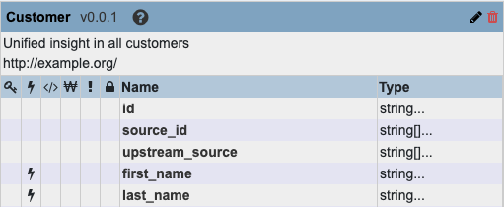
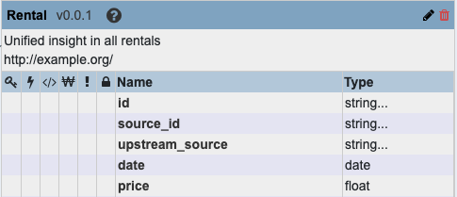
Business entities
CRM
Rentals
Marketing

